Slide 1
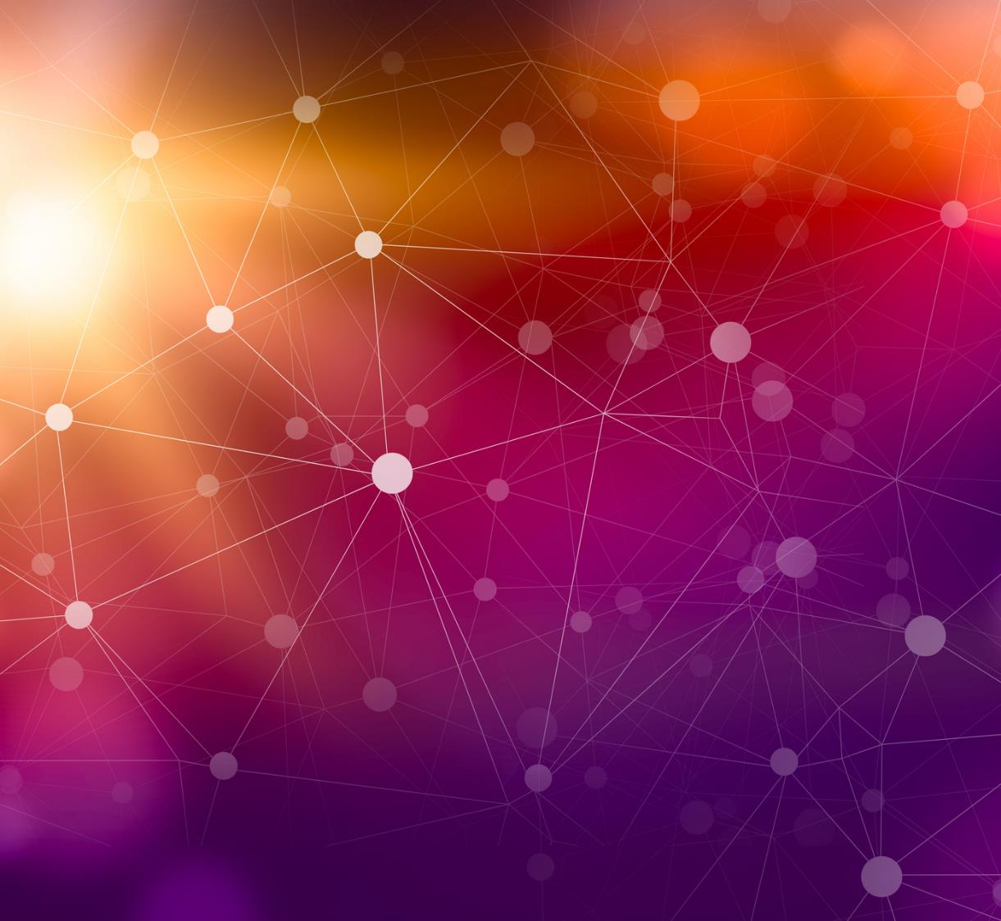
Unsupervised Learning for crypto markets
Inder Grang

Slide 2
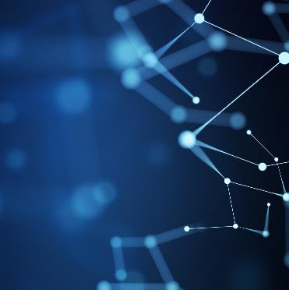
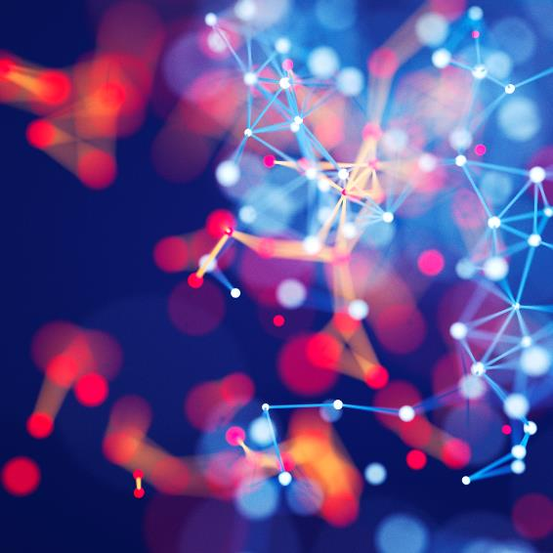

Topics
Summary
Results with TSNE
Results with KMeans

Slide 3

Summary
Kmeans provided a good classification for the data. There are 3 clusters
TSNE gave more or less 2 clusters but it wasn’t a strong classification.

Slide 4
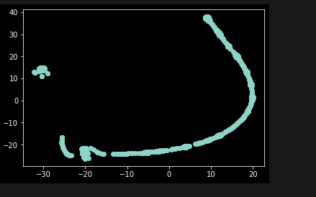
Results from TSNE

Slide 5
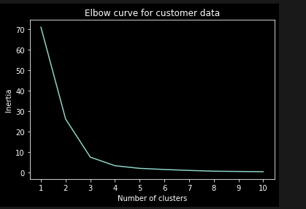
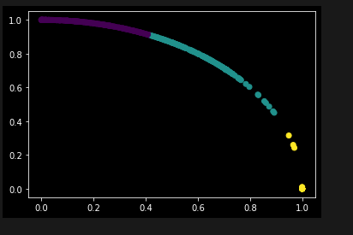
Results from KMeans

